Slide 1

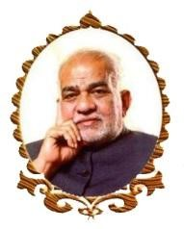
SMART SHOE for HEALTH FITNESS USING IoT
BVRIT HYDERABAD College of Engineering for Women
Department of Information Technology
Team- 8
C. Neha Reddy(1262)
K. Deekshita(1273)
S. Sravani(1280)
B. Sai likhitha(1298)
Under the Guidance of
Guide Name: Ms. K.S.Niraja
Assistant Professor

Slide 2
Contents
Summary
Architecture
Implementation
Execution Video
Results
Conclusion & Future Scope

Slide 3
Nb Summary
Cancer is a group of diseases characterized by the uncontrolled growth and spread of abnormal cells. If the spread is not controlled, it can result in death. Lung cancer was the most common cancer in worldwide, contributing 2,093,876 of the total number of new cases diagnosed in 2018.
The incidence rate has been declining since the mid- 1980s in men, but only since the mid-2000s in women, because of gender differences in historical patterns of smoking uptake and cessation.
Cigarette smoking is by far the most important risk factor for lung cancer; 80% of lung cancer deaths in the US are still caused by smoking.
The project had designed in such a way that anyone who do running or walking by wearing these uniquely designed shoe they will get to know how many steps they have walked and if the person sits ideal for sometime then he’ll get a warm up message and if he do over exercise(walking or running) then he will get a rest for a while notification. And there will be also a water remainder to help the user to avoid dehydration.

Slide 4
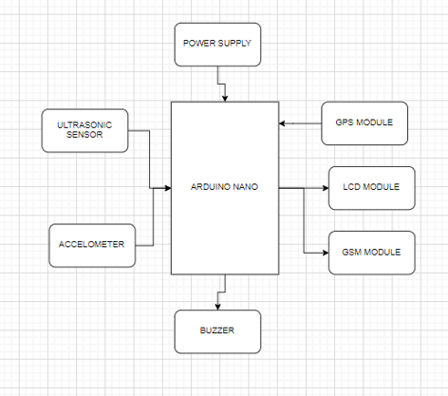
Implementation System Architecture

Slide 5
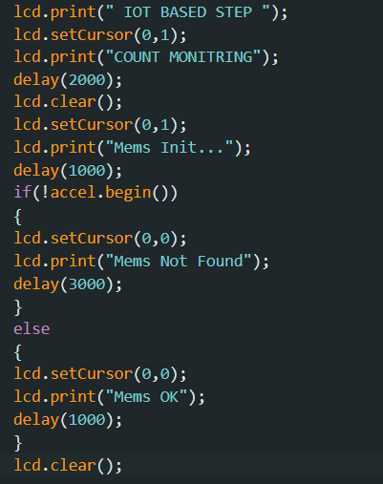
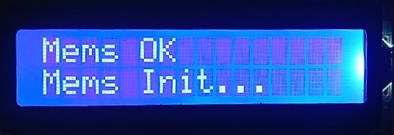
Movement Detection

Slide 6
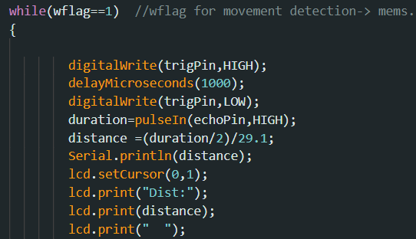
Distance Calculation

Slide 7
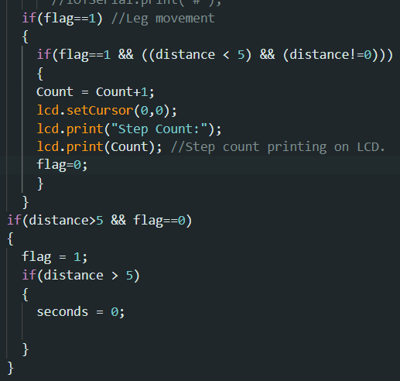
Calculating Step Count

Slide 8
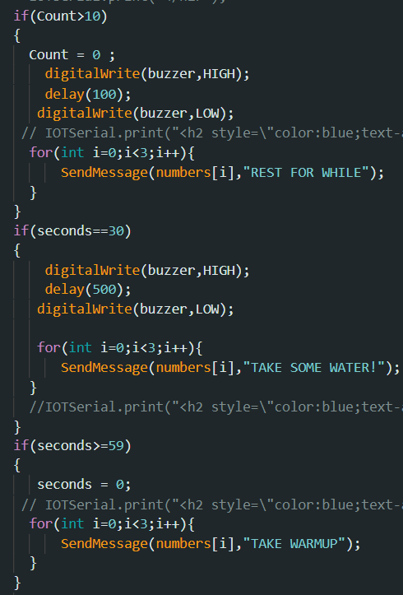

Slide 9
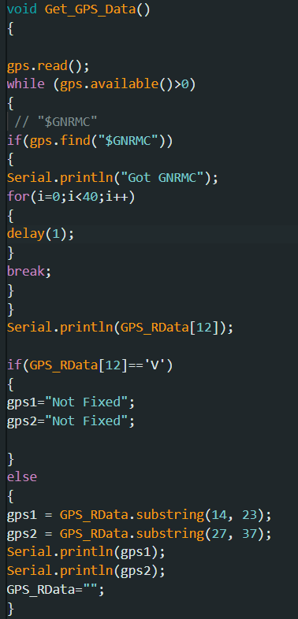
GPS

Slide 10
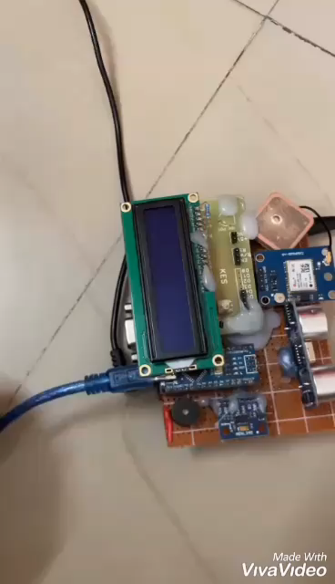
Execution Video

Slide 11
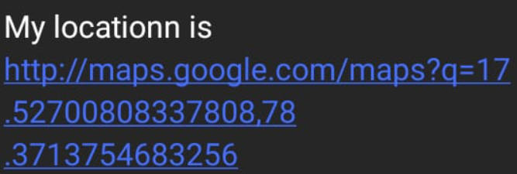
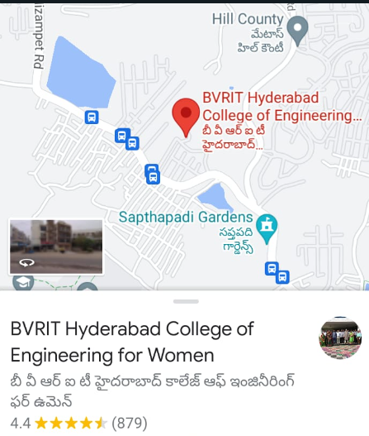



Result

Slide 12
Conclusion & Future Scope
The proposed system consists of embedded features as: Step Count, helping from over exercise through walking and running by remaindering user to take some rest through "Rest for a while" message, helping user from dehydration by giving him water remainder message, if the user sat ideal for some time then remaindering him to do some exercise by giving "Warm up" message and also tracks the user’s location with the help of GPS device. This whole process is done by sending SMS to our mobile phones with the help of GSM module.
In the future, our device can also helps parents in tracking children location when they went for playing or when they lost. Extending multi-functional Smart Shoe related applications can be created.

Slide 13
Thank You

